Slide 1
BIOMETRIC LOCKING BOX
Project Proposal
Abigail Duran, Ethan Wells, Alexis Perez
10/22/25

Slide 2
PROBLEM IDENTIFICATION
Traditional safety boxes usually rely on keys or passcodes and can easily be lost, and fingerprint-activated safety boxes are typically overpriced.
This project aims to design a fingerprint-activated safety box that provides cost-efficient, secure, and user-specific access using biometric authentication.
This project will demonstrate embedded control, sensor integration, and secure storage design.

Slide 3
USER REQUIREMENTS
Easy install
Low Cost
Low Power
Fast

Slide 4
ENGINEERING REQUIREMENTS
The fingerprint sensor must correctly identify an enrolled user with ≥95% accuracy.
The locking solenoid must respond within 1 seconds of fingerprint verification.
The system must be powered by no more than 12V dc power.
The system must operate continuously for at least 8 hours.
The box must lock automatically after 10 seconds of inactivity.
Must be able to store and check for at least 5 different fingerprints.

Slide 5
HARDWARE COMPONENTS
Arduino Uno
Breadboard and jumper wires
Fingerprint sensor module
Locking Solenoid
Power supply
Relay
Box

Slide 6
SOFTWARE
Arduino IDE

Slide 7
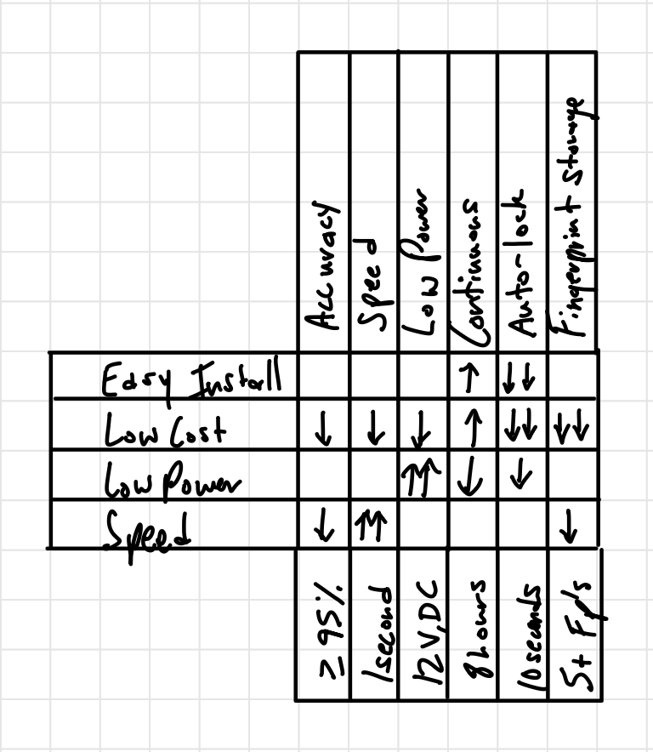
QFD CHART

Slide 8
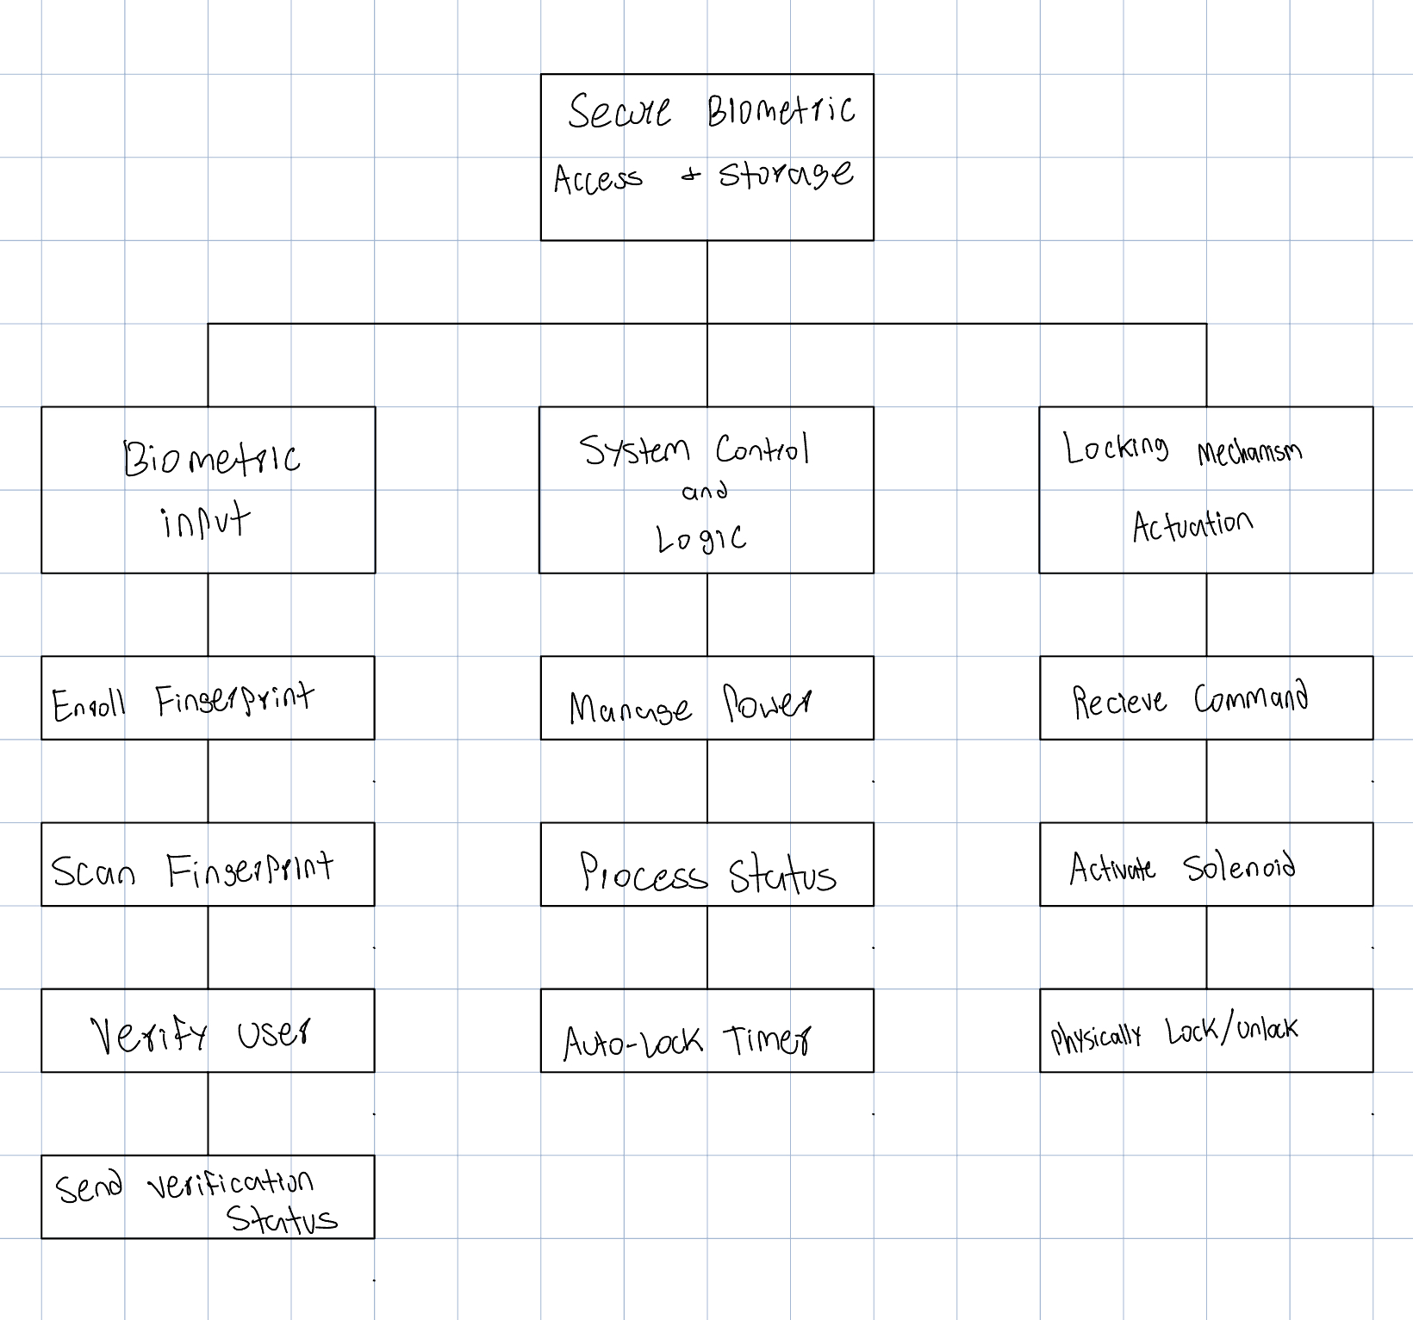
FUNCTIONAL DECOMPOSITION DIAGRAM

Slide 9
TASK LIST
A = Schematic and bill of materials (1 week)
B = Hardware setup, build prototype (1 week)
C = Software development, integrate fingerprint library, confirm fp identification and accuracy (1 week)
D = System Integration, add timer to locking solenoid, mount into the enclosure. (1 week)
E = Testing and Optimization, Run tests to meet all engineering requirements. (1 week)
F = Finalization, full demo run, prepare final report and rehearse presentation. (1 week)
Total time is 35 days, or 5 weeks

Slide 10
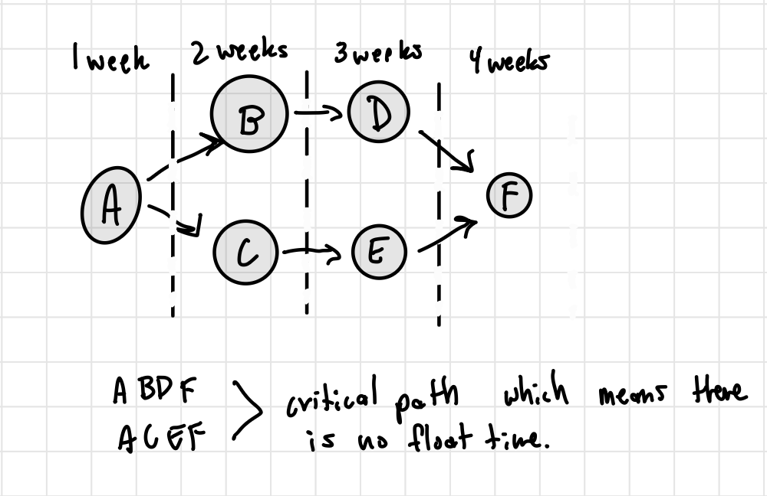
Network Diagram

Slide 11
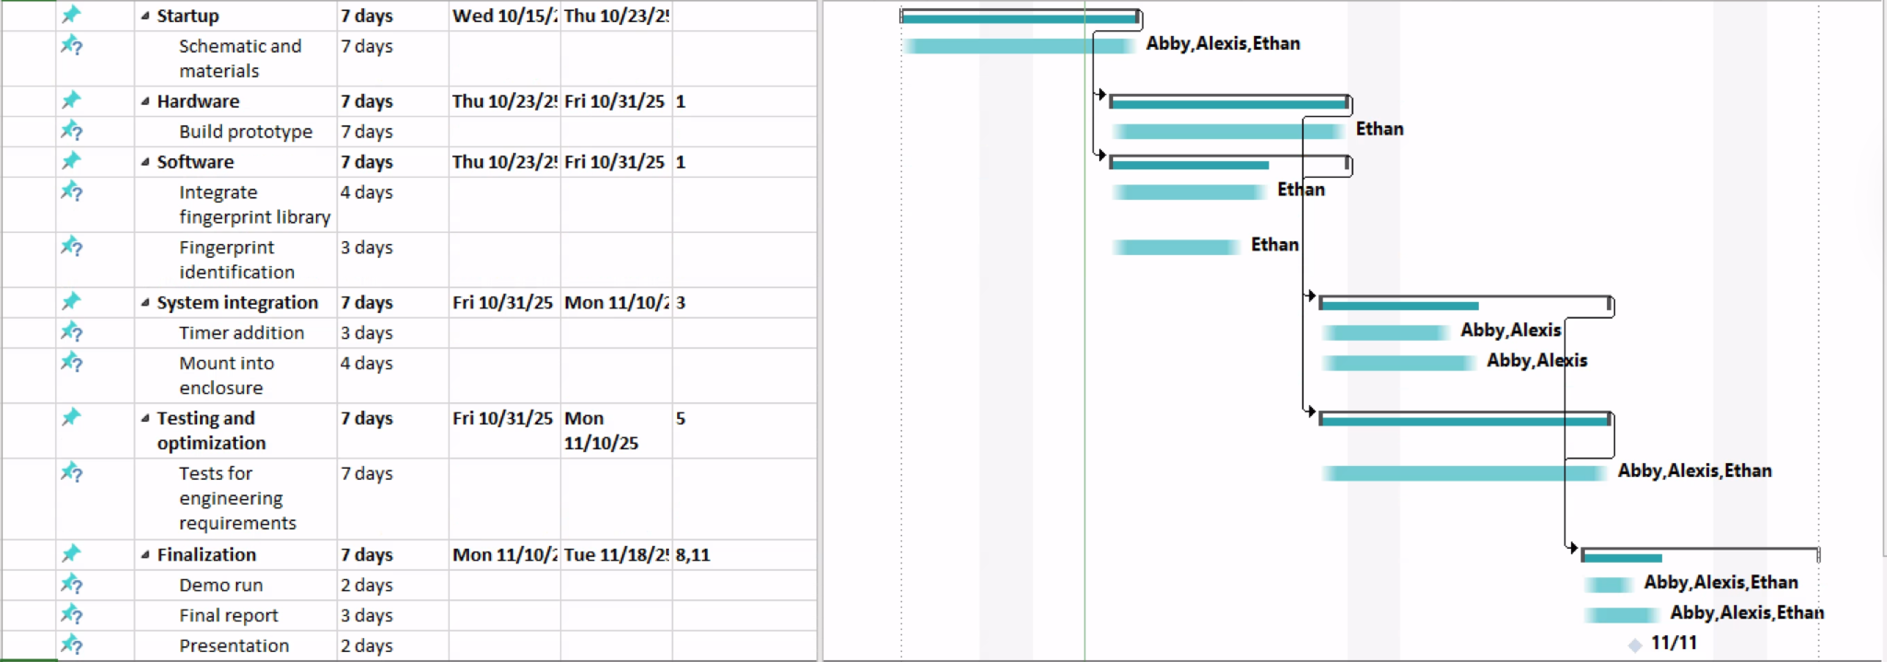
GANTT CHART

